Slide 1

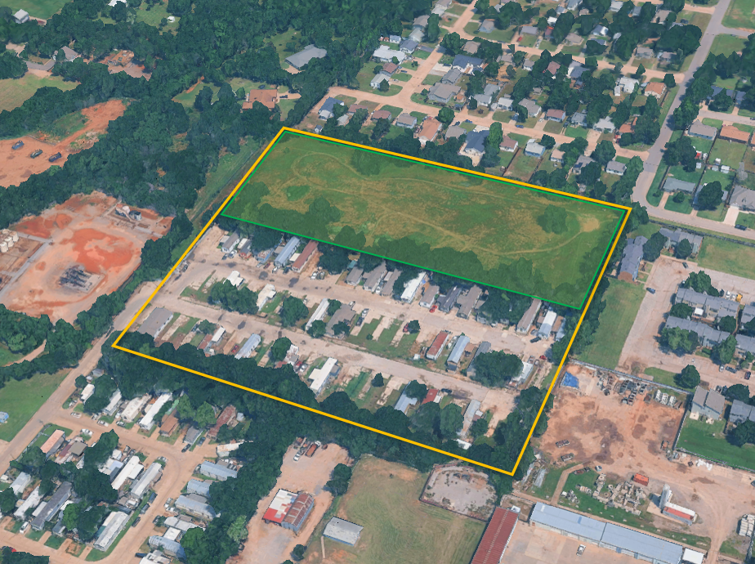
Bethany MHP - North Field Rezoning
1

Slide 2
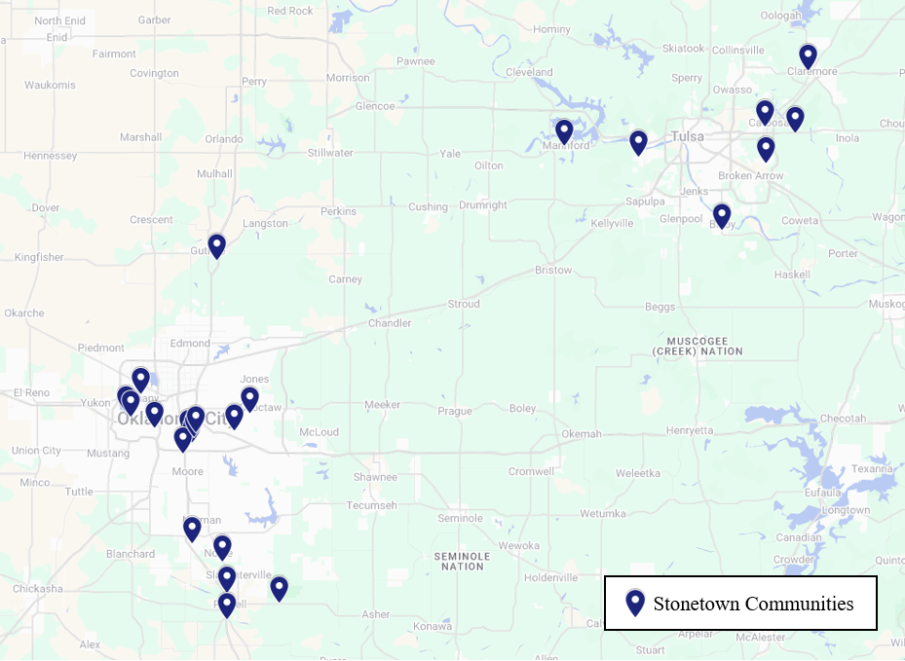
Stonetown Oklahoma Portfolio Overview
26 communities across Oklahoma, including 19 in the OKC metro area. Have been purchasing in the metropolitan area since 2011.
3,325 total lots
1,413 homes installed
Approximately $101M invested in community improvements and new homes
Long-Term ownership history. Most communities that we purchased from 2011 onwards we still own. We like to buy, but do not like to sell.

Slide 3
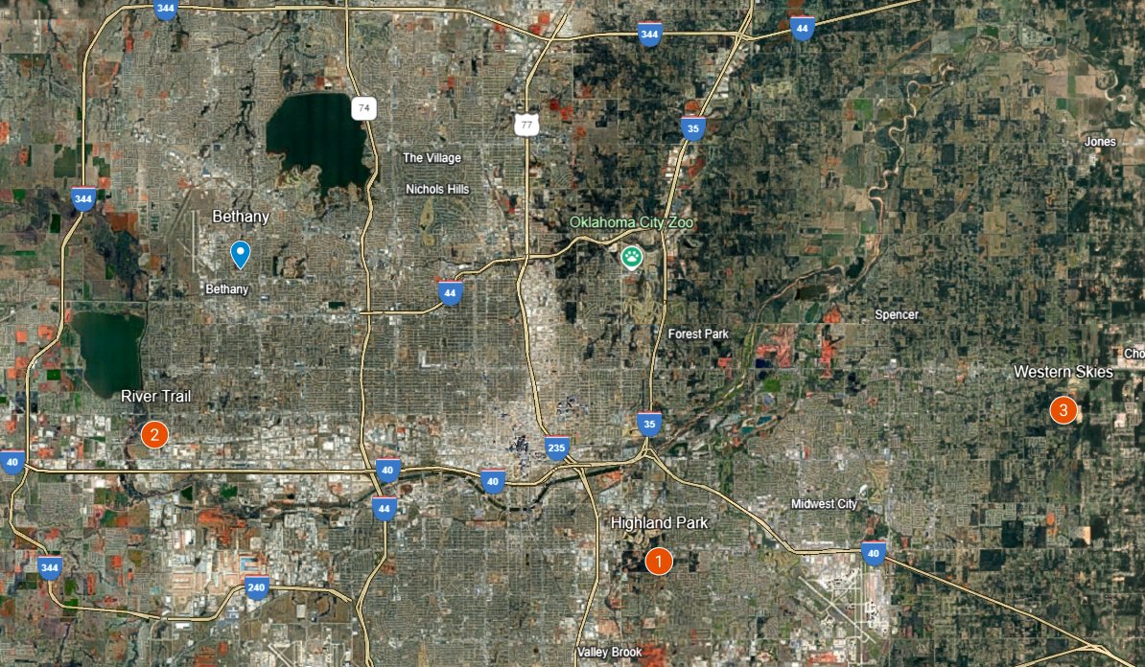
Stonetown Case Study Communities
Bethany MHP
Highland Park
River Trail
Western Skies

Slide 4
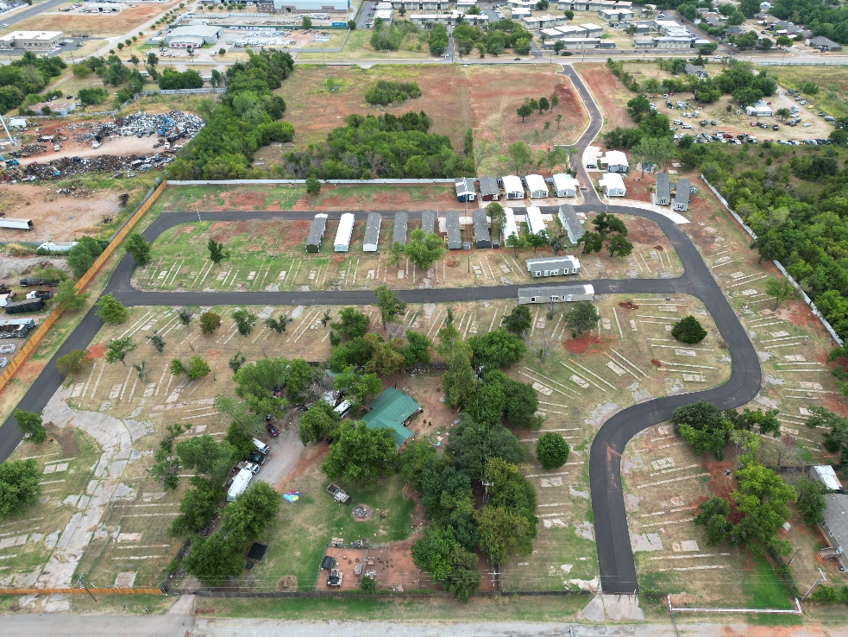
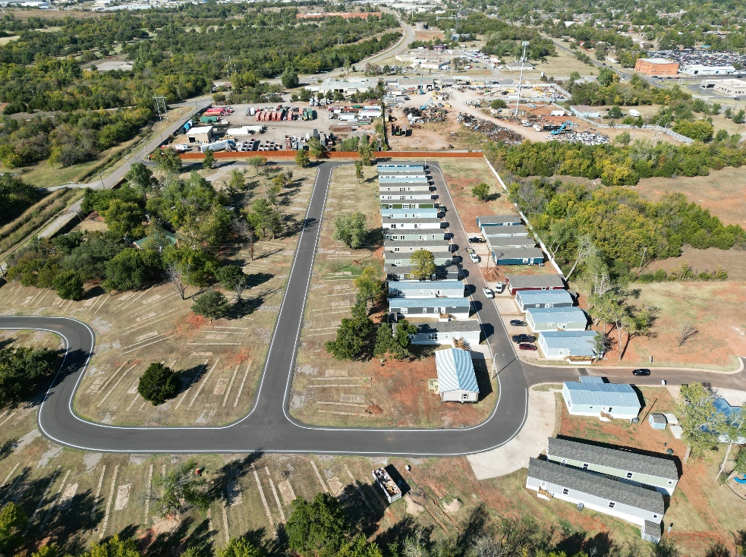
Highland Park (border of Del City & Oklahoma City)
Former 110-lot community acquired fully vacant in February 2018.
Stonetown acquired the defunct community, abandoned since 2008, and began a full revitalization by repaving roads, upgrading utility infrastructure, and installing a new office and playground.
New concrete driveways are being installed with each new home.
To secure a new connection to Oklahoma City’s municipal water, Stonetown worked with the city to implement a cost-effect new water main and easement.
August 2022
October 2022

Slide 5
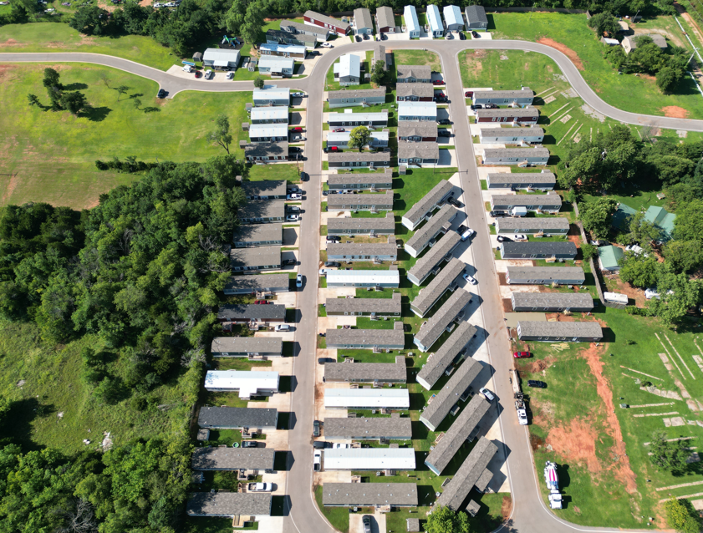
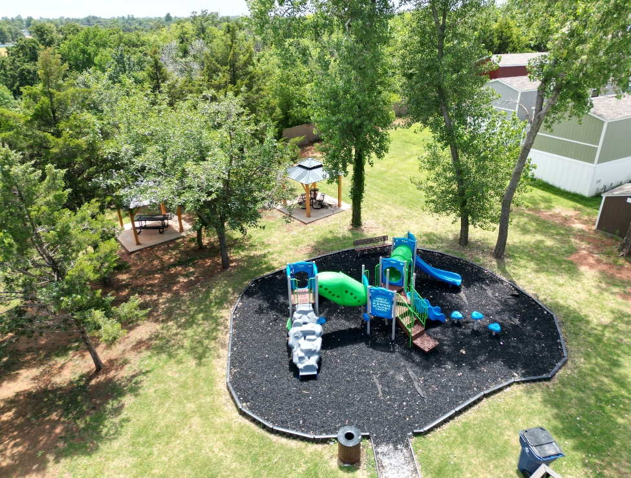
Highland Park Today
80 homes installed so far
Occupancy is at 82% today and growing. Targeting full occupancy in 2027.
Invested $7.5M to date to revitalize community and new homes installations.
Acquired adjacent land and secured MH zoning to grow community potential to 145 lots.
July 2025 Aerial Photo
New Playground & Pavilions

Slide 6
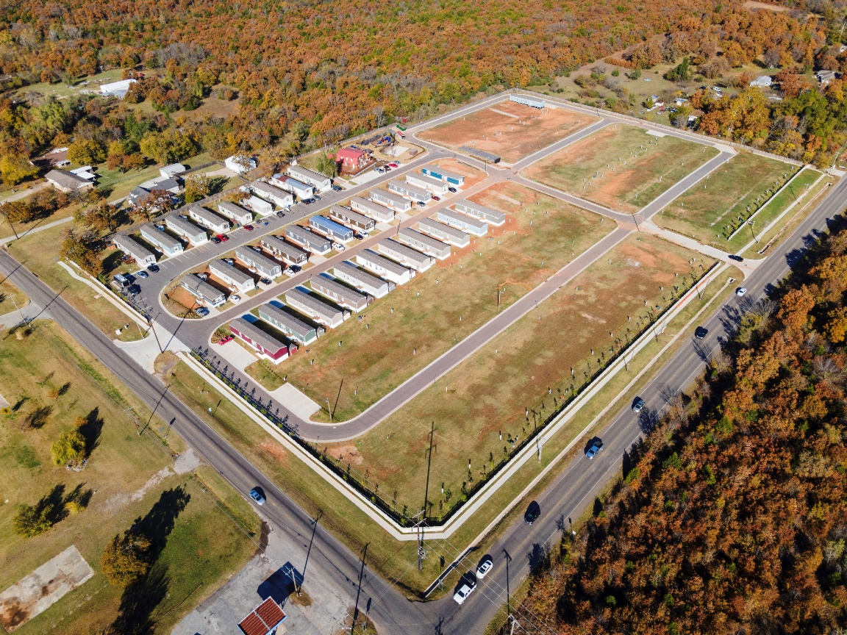
Western Skies (Choctaw)
102-lot partially-redeveloped (no water or sewer), vacant community purchased through a sheriff’s department lien sale in June 2019.
The community came with unresolved issues, including unpaid bills, municipal zoning challenges, and irate neighbors.
Stonetown resolved zoning problems and community tensions through multiple meetings with the Choctaw City Council and adjacent homeowners.
November 2021

Slide 7

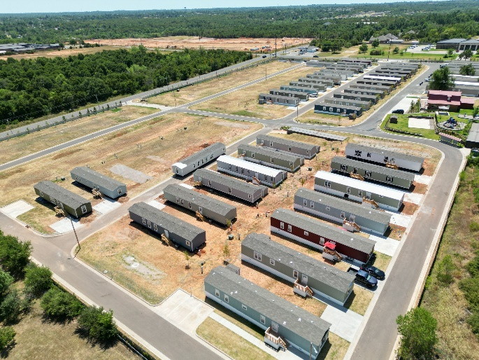
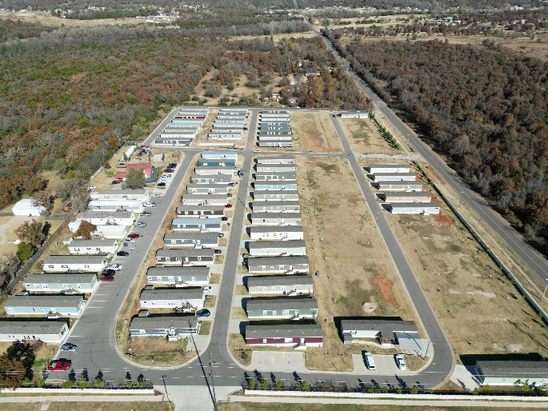
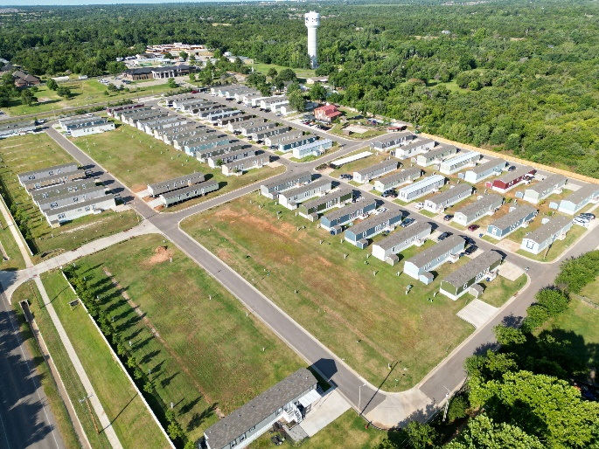
Western Skies Progress Photos
November 2021
July 2022
November 2023
June 2024

Slide 8
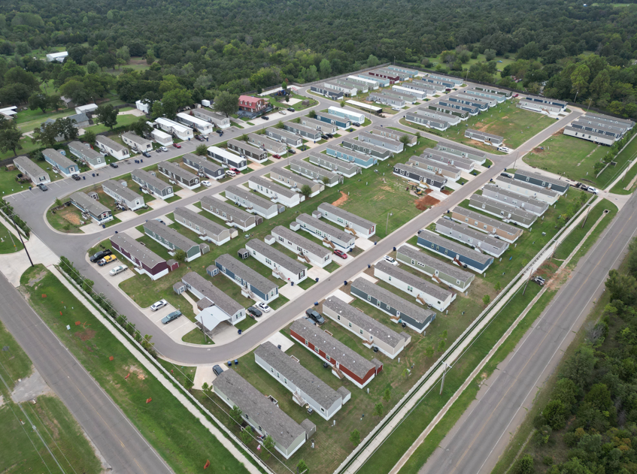
Western Skies Today
95 new homes purchased and installed
Occupancy at 93% today. Targeting 100% by year-end.
To date, $8.2M has been invested in community improvements and new homes.
8

Slide 9
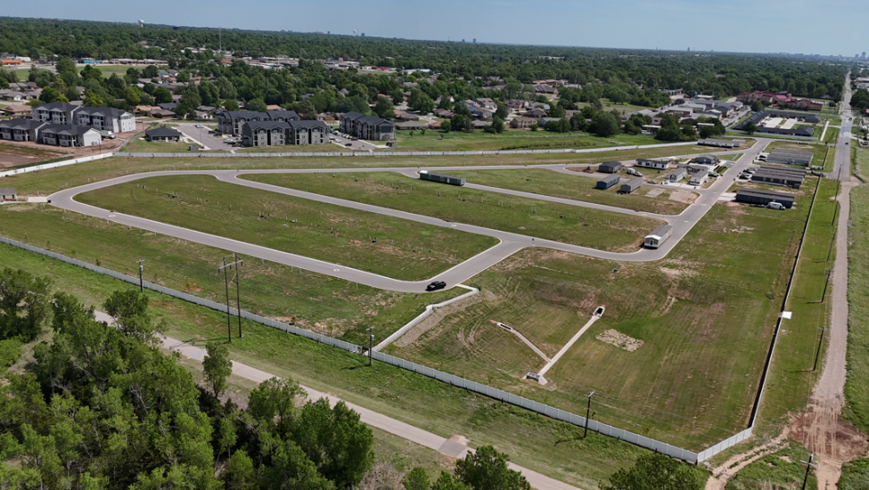
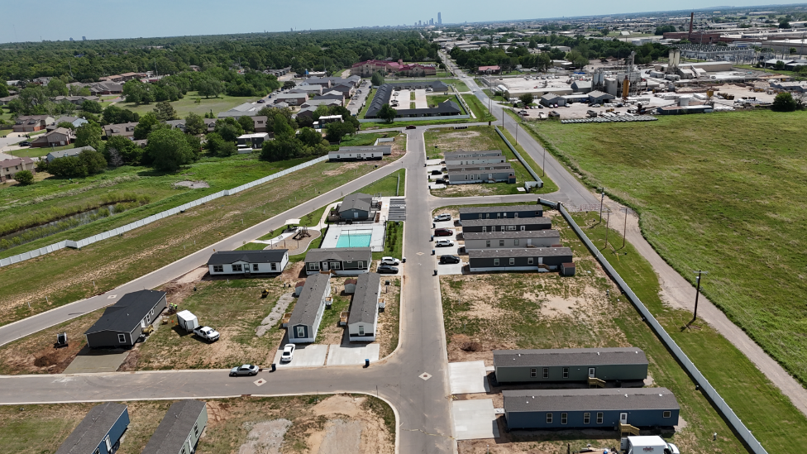
Reserve on River Trail
26-acre parcel acquired in June 2022 to be the first newly developed manufactured housing community in metro OKC in 30+ years.
The developed community has 162 lots, with an office/clubhouse and enhanced amenities including a pool and playground.
Roads have been paved and concrete driveways are being poured as homes are delivered.
To date, $7.5M has been invested in the development.
The community Grand Opening was in early 2026 and 20 new homes have been installed so far.
April 2026
April 2026

Slide 10
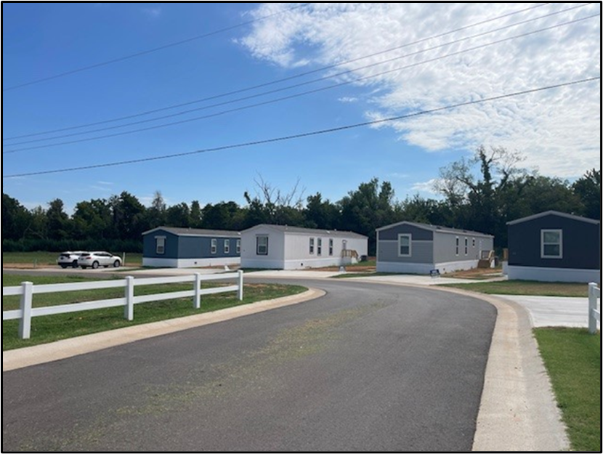
Manufactured Housing Development & Redevelopments
These three projects will, at completion, combine to provide 409 new homes of approximately 1,200 square feet, each with 3 bedrooms, 2 bathrooms, and 2-3 car parking.
Each brand-new home costs less than $90,000 and is available for immediate sale or purchase on a long-term contract.
Collectively, these projects will broaden the range of housing options in OKC, Del City, and Choctaw, introducing new homes in well-amenitized communities for 1,600-2,000 residents.
We aspire to do the same in Bethany.
10

Slide 11
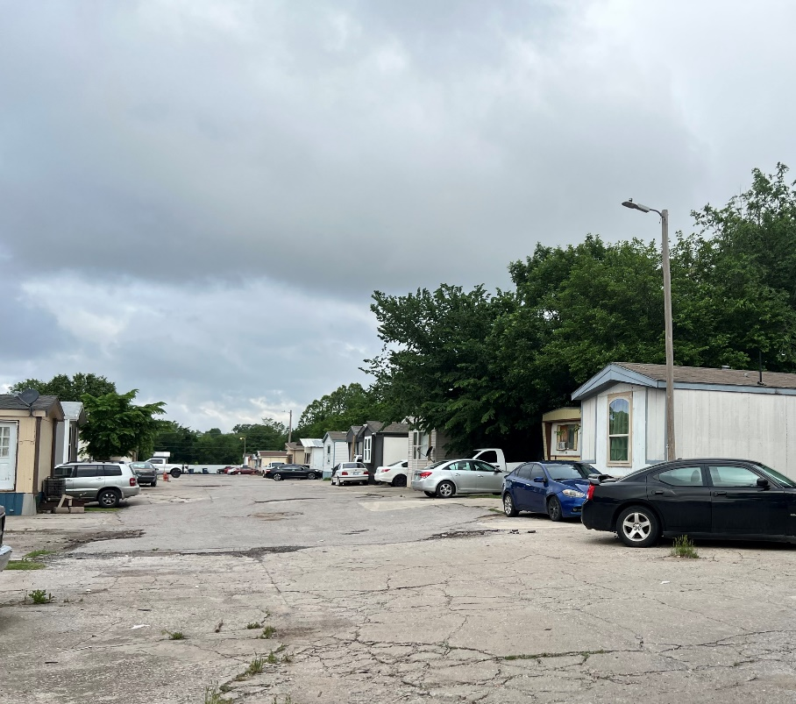
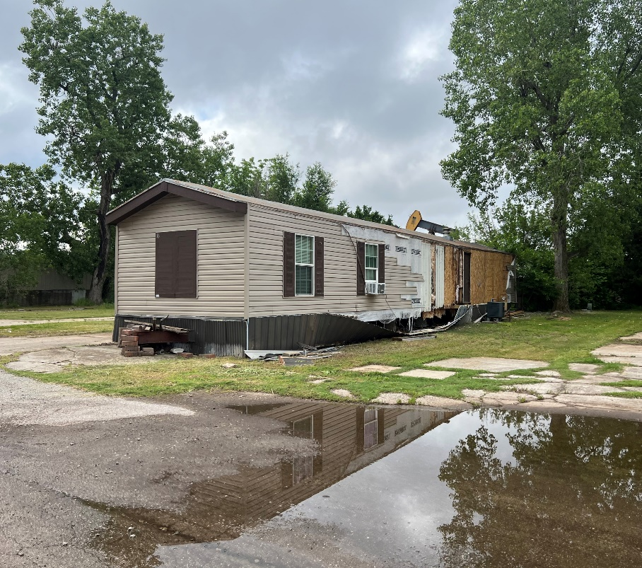
Bethany MHP at Acquisition
Stonetown purchased Bethany Mobile Home Park on North Peniel Ave in June 2025.
At acquisition, the community consisted of 57 lots that were 58% occupied with a severely aged housing stock and failing infrastructure.
Lacked pride of ownership and active management.
Had an immediate need for major capital improvements (roads, driveways, new homes, signage, etc.).
11

Slide 12
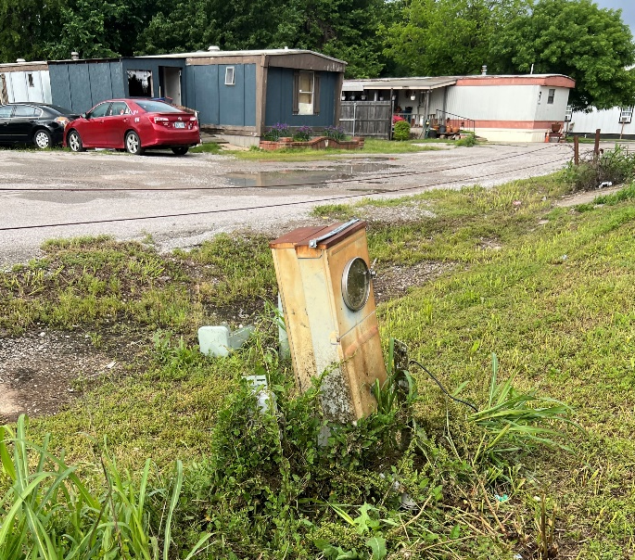
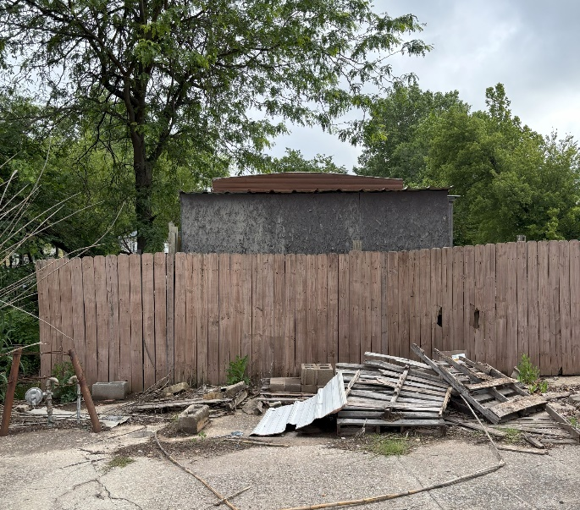
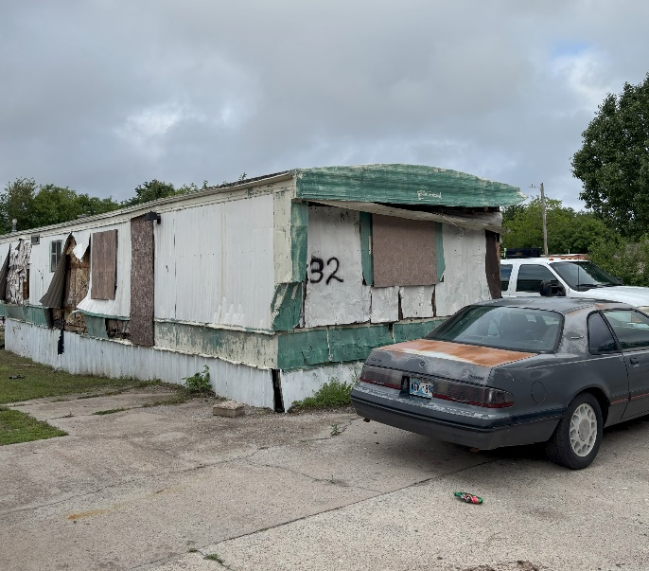
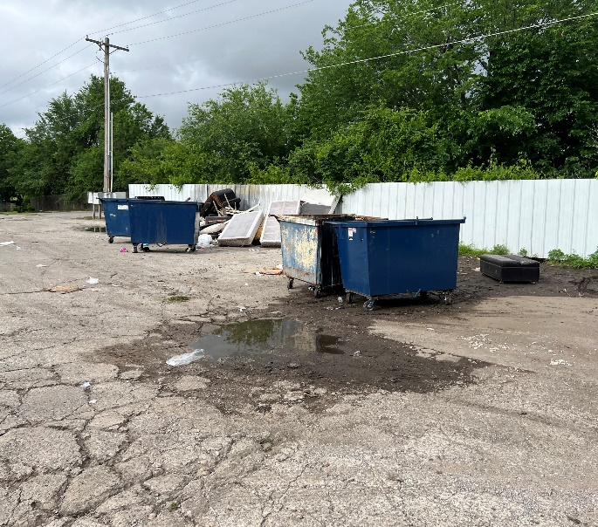
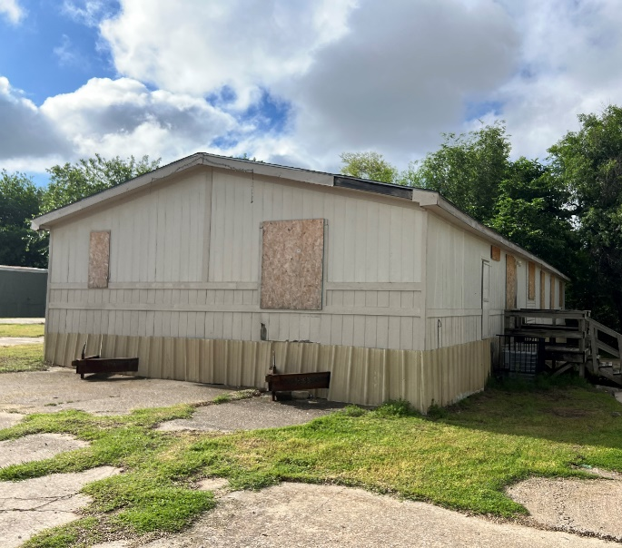
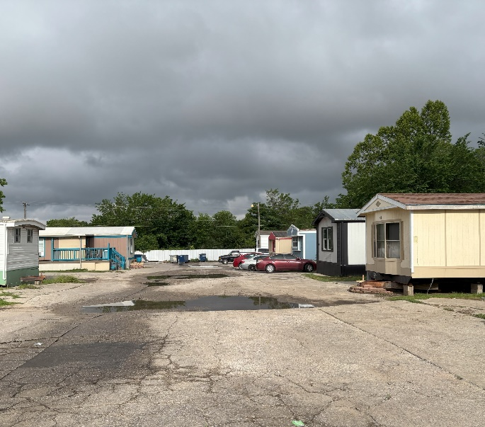
Bethany MHP at Acquisition
12

Slide 13
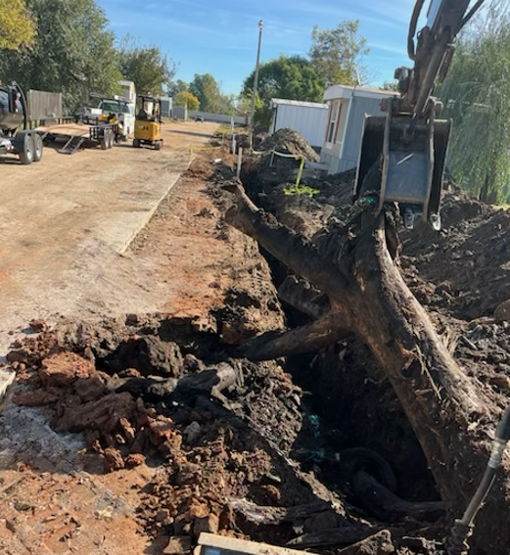
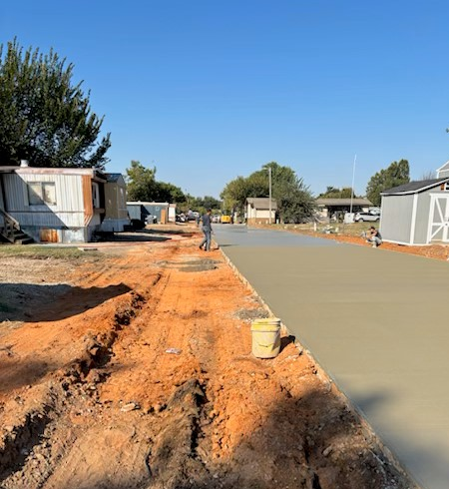
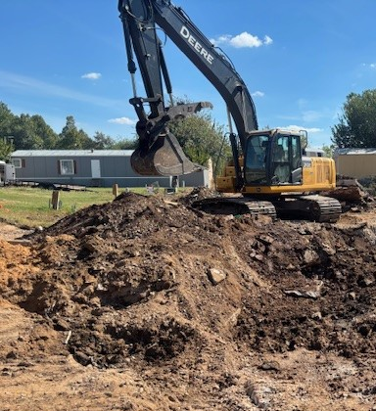
Bethany MHP Redevelopment Plan
When we purchased Bethany Mobile Home Park, our redevelopment plan included the following:
  Pave new concrete roads throughout, down to the road base
  Install new homes on all vacant lots within first 4 years of ownership
  Pour new driveways for all 57 lots over time as homes were installed
  Plant landscaping throughout the community
  Create new evident pride of ownership by both homeowners and landlord
  Develop the vacant 4-acre parcel to the north as state of the art, modern manufactured housing
13

Slide 14
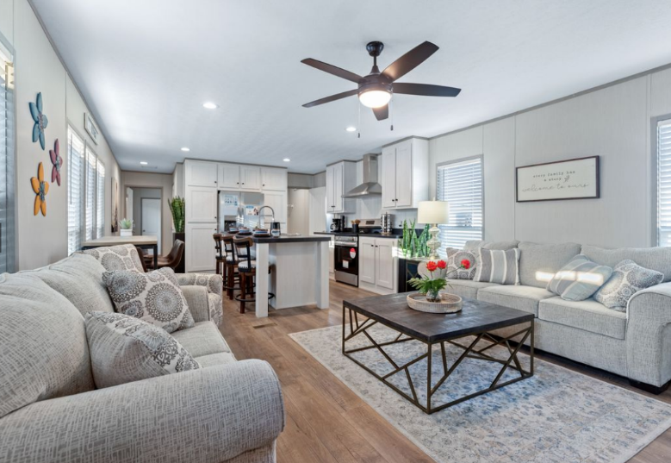
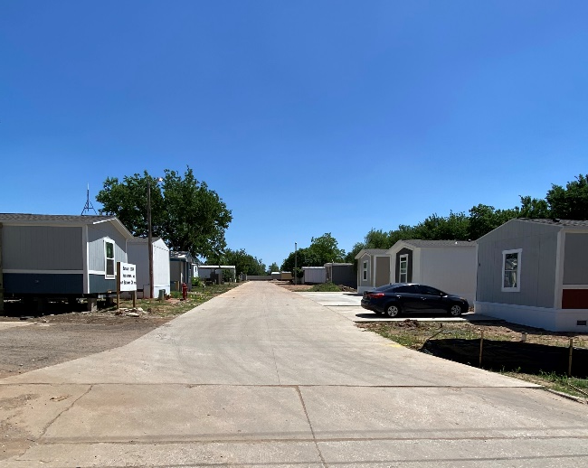
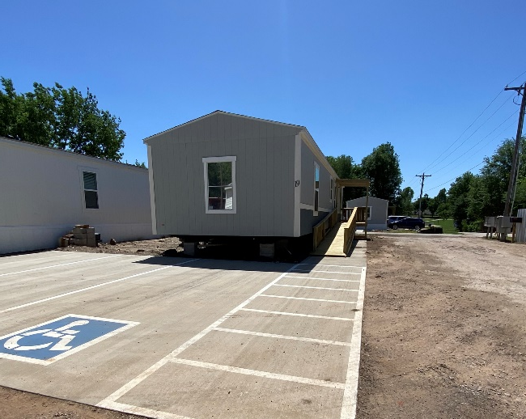
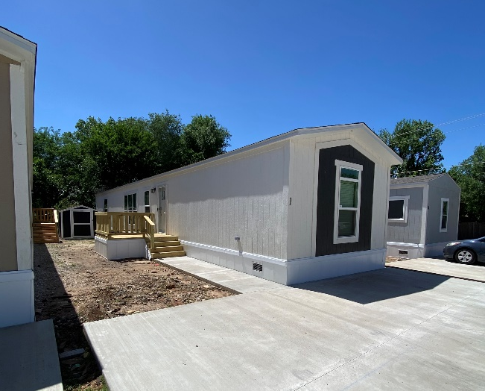
Bethany MHP Today
Infrastructure improvements are mostly complete
  Existing roads removed and repaved with new concrete
  Portions of water & sewer lines replaced throughout
  Abandoned homes removed and lots are being restored
New home installations underway – residents are moving in
  3 Bed / 2 Bath, 1,056–1,216 sq ft
  Concrete 2–3 car parking pad
  8×8 storage shed included with each new home
Strong market demand
  100% of delivered homes have approved applications with a waiting list
New Home Interior Example
New Concrete Roads
Office Installation
New Homes

Slide 15
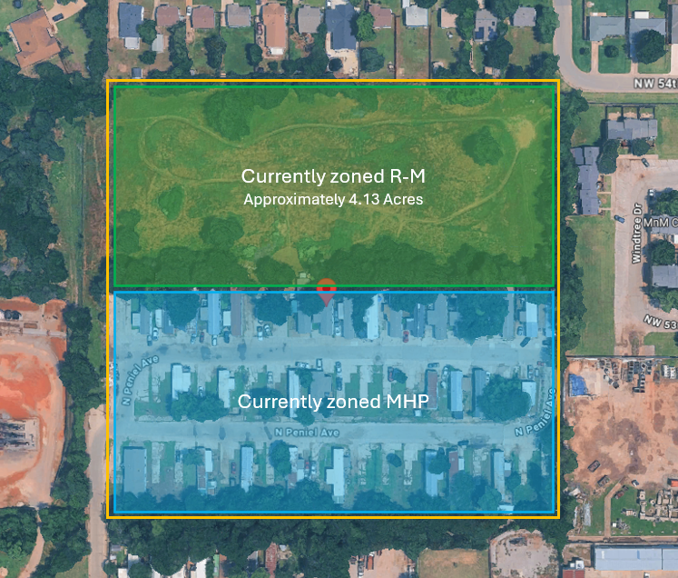
Bethany MHP North Field Expansion
Stonetown is seeking approval to rezone ~4 acres of vacant land to the north of the existing community.
15

Slide 16
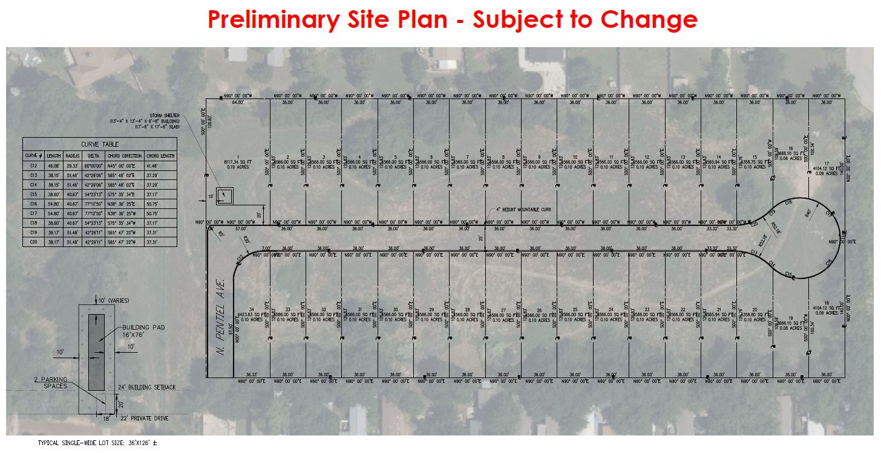
Bethany MHP North Field Expansion
We plan to build an additional 34-lots measuring at least 4,100 square feet each.
Project will be engineered to City standards including road width and cul-de-sac measurements with access via the existing community
All new construction of roads and utility infrastructure
All new 3-bedroom, 2-bathroom, homes with 2-3 car parking pads
16

Slide 17
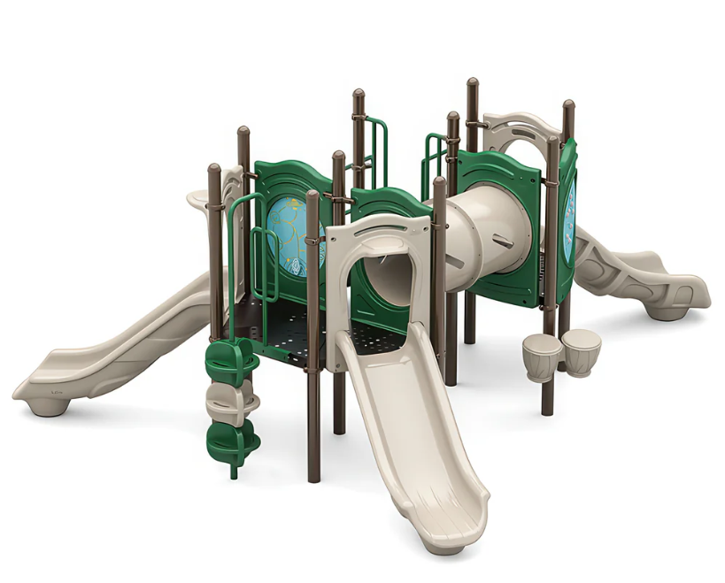
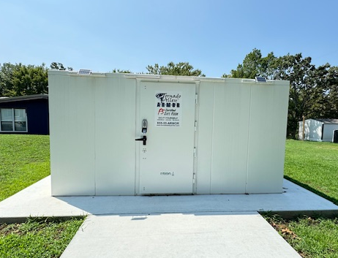
Bethany MHP North Field Expansion
We are proposing to contribute funding toward a new playground at nearby Macrory Park – a shared amenity that benefits both our residents and the broader Bethany community
The new expansion will also include an above-ground tornado shelter, providing critical safety infrastructure that the community currently lacks
17

